Slide 1
Qhack 2023
Selected challenges and its solution

Slide 2
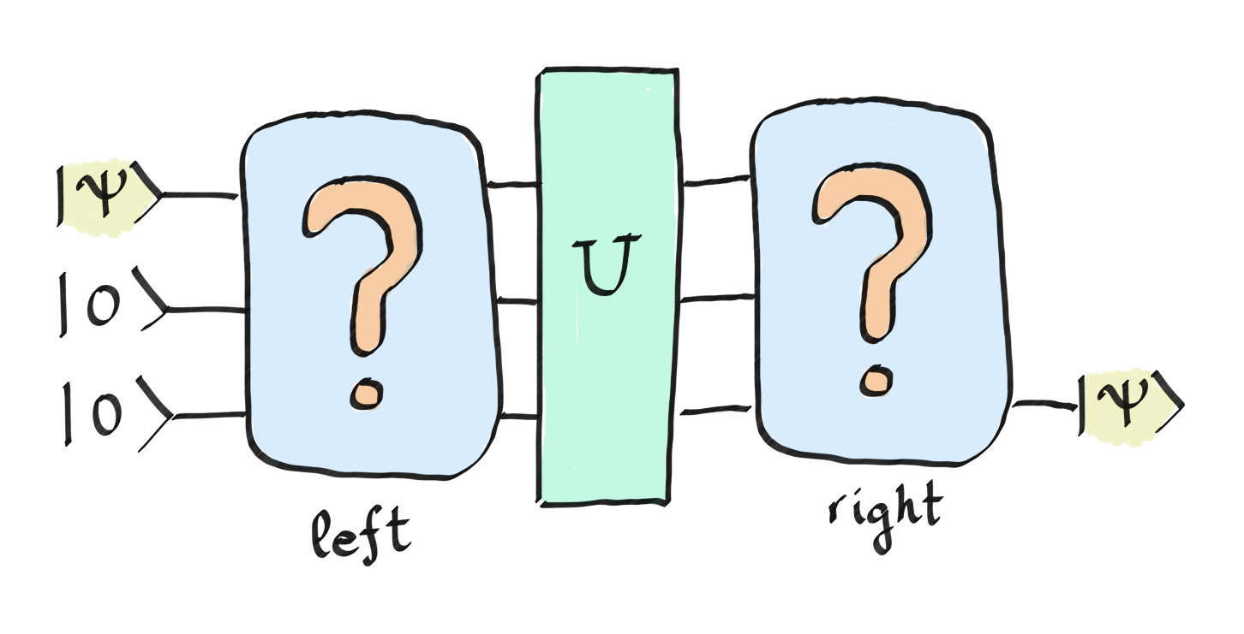
Challenge: the change of qubits
In this case, consists of one PauliX gate that we place randomly in one of the three qubits (each time, the gate is generated in a different wire). You should be able to complete the circuit so that, regardless of the randomly generated operator , you are able to move the state from the first qubit to the last qubit.
Restrictation: don’t use any gate between wire 0 and wire 2
Noise operator

Slide 3

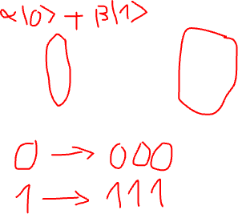
Challenge: the change of qubits
This challenge relevant to the topic quantum error correction and its solution named bit flip code. The repetition code works in a classical channel, because classical bits are easy to measure and to repeat. This approach does not work for a quantum channel in which, due to the no-cloning theorem, it is not possible to repeat a single qubit three times

Slide 4
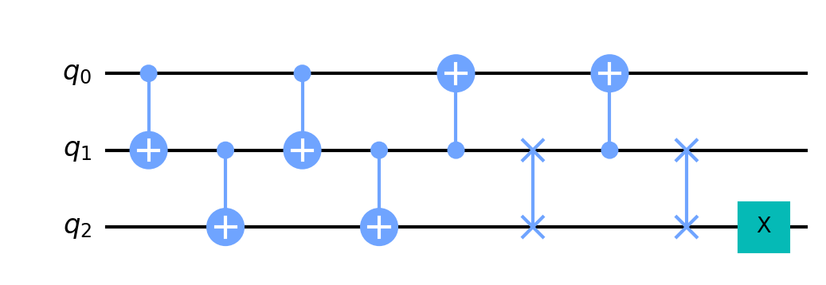
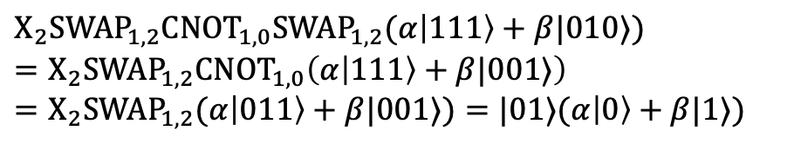

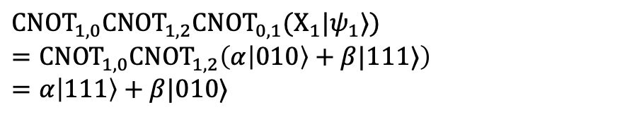
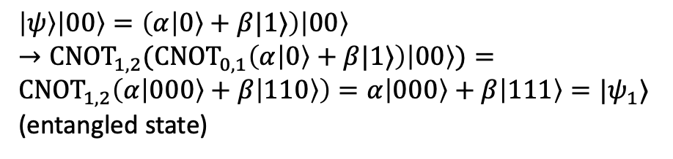
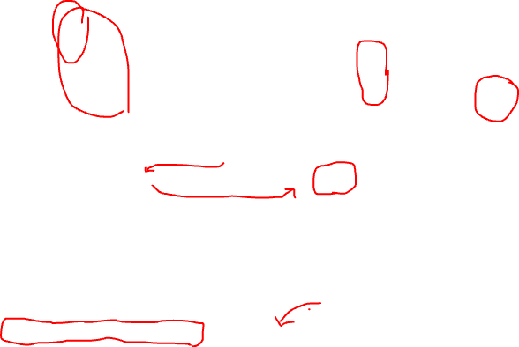
Challenge: the change of qubits (Solution)
Random
X gate
$\left|ψ\right\rangle \left|00\right\rangle =\left(α\left|0\right\rangle +β|1⟩\right)\left|00\right\rangle$
$→{{CNOT}_{1,2}(CNOT}_{0,1}\left(α\left|0\right\rangle +β|1⟩\right)\left|00\right\rangle )={CNOT}_{1,2}\left(α\left|000\right\rangle +β\left|110\right\rangle \right)=α\left|000\right\rangle +β\left|111\right\rangle =|ψ_{1}⟩$ (entangled state)
$$Example: X_{1}|ψ_{1}⟩$$
${{{CNOT}_{1,0}CNOT}_{1,2}CNOT}_{0,1}(X_{1}|ψ_{1}⟩)$
$={CNOT}_{1,0}{CNOT}_{1,2}\left(α\left|010\right\rangle +β|111⟩\right)$
$=α\left|111\right\rangle +β|010⟩$
${X_{2}SWAP}_{1,2}{CNOT}_{1,0}{SWAP}_{1,2}(α\left|111\right\rangle +β|010⟩)$
$={X_{2}SWAP}_{1,2}{CNOT}_{1,0}\left(α\left|111\right\rangle +β|001⟩\right)$
$={X_{2}SWAP}_{1,2}(α\left|011\right\rangle +β|001⟩)=|01⟩(α\left|0\right\rangle +β|1⟩)$

Slide 5
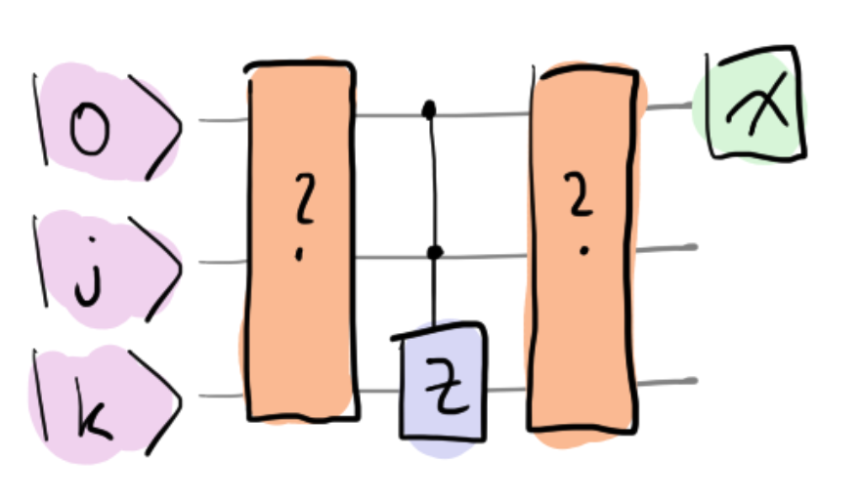
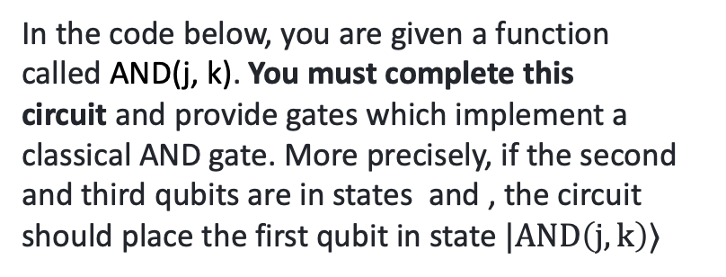

Challenge: Ctrl-Z
In the code below, you are given a function called AND(j, k). You must complete this circuit and provide gates which implement a classical AND gate. More precisely, if the second and third qubits are in states and , the circuit should place the first qubit in state $|AND\left(j,k\right)⟩$

Slide 6
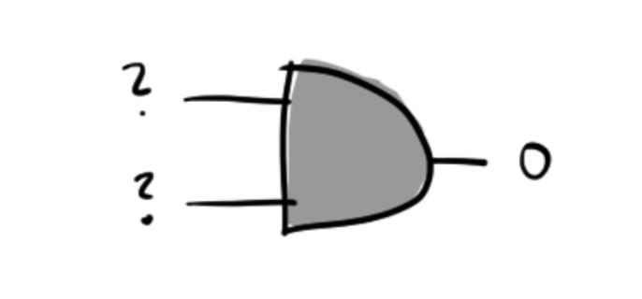

Challenge: Ctrl-Z (Idea)
In classical, we don’t know the input because the dimensional of output state < the dimensional of input state.
In quantum computing, the dimensional of output state = the dimensional of input state.

Slide 7
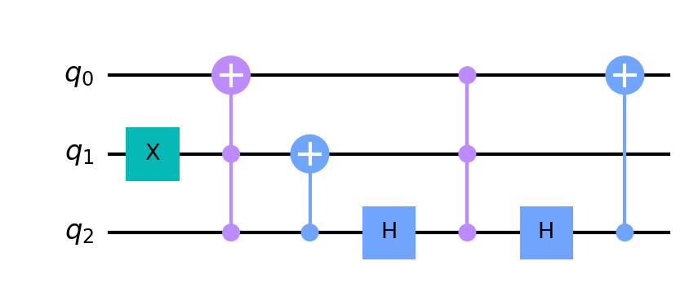
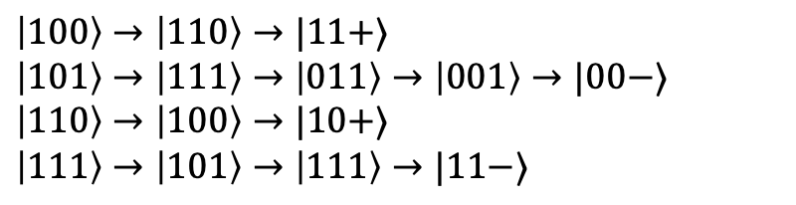
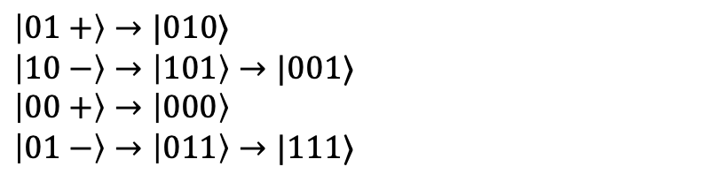
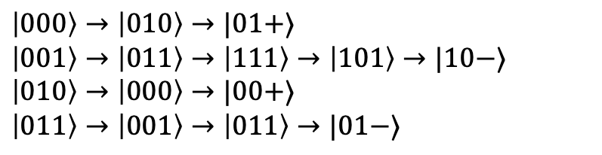

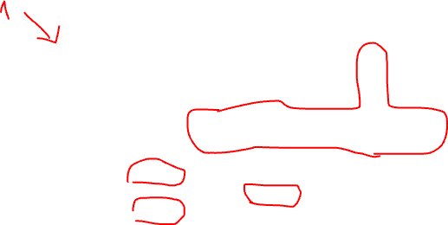


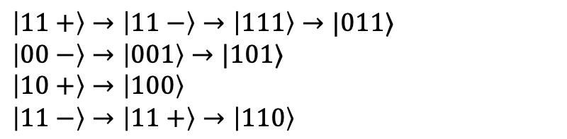
Challenge: Ctrl-Z
$$|0⟩$$
$$|j⟩$$
$$|k⟩$$
$\left|000\right\rangle →\left|010\right\rangle →|01+⟩$
$\left|001\right\rangle →\left|011\right\rangle →\left|111\right\rangle →\left|101\right\rangle →|10−⟩$
$\left|010\right\rangle →\left|000\right\rangle →|00+⟩$
$\left|011\right\rangle →\left|001\right\rangle →\left|011\right\rangle →|01−⟩$
$\left|01+\right\rangle →|010⟩$
$\left|10−\right\rangle →\left|101\right\rangle →|001⟩$
$\left|00+\right\rangle →\left|000\right\rangle$
$\left|01−\right\rangle →\left|011\right\rangle →|111⟩$
$\left|100\right\rangle →\left|110\right\rangle →|11+⟩$
$\left|101\right\rangle →\left|111\right\rangle →\left|011\right\rangle →\left|001\right\rangle →|00−⟩$
$\left|110\right\rangle →\left|100\right\rangle →|10+⟩$
$\left|111\right\rangle →\left|101\right\rangle →\left|111\right\rangle →|11−⟩$
$\left|11+\right\rangle →\left|11−\right\rangle →\left|111\right\rangle →|011⟩$
$\left|00−\right\rangle →\left|001\right\rangle →|101⟩$
$\left|10+\right\rangle →\left|100\right\rangle$
$\left|11−\right\rangle →\left|11+\right\rangle →\left|110\right\rangle$

